Slide 1

Final Project Presentation
Yong Seok (Tommy) Lee, Duc Minh Dao
Notes:
Hello everyone, we are Tommy and Duc, and today we will be presenting our web application, Artket.

Slide 2
Introduction of Product
Notes:
First things first, we want to give a brief introduction of the product we are making.

Slide 3
What is it for?
eBay for art
Online auction website for art
Bid for artwork
Sell artworks
View information regarding the artpiece (e.g. artist and genre)
Filter through artworks based on genre, artist, and price
Main goal: provide an online platform for art and items of value
Notes:
The first question to ask is: What is it for? Artket can be summarized in one sentence as “eBay for art”. It is an online auction website for art, where users can bid for artworks, sell artworks, view information regarding the artpiece, and use to identify the paintings that they would like.
The main goal of the web application is to provide an online platform for users who are interested in art and items of value. There is an emphasis on online platform, as the goal is to provide an alternative to real-life auction houses, which incurs a lot of overhead costs when purchasing art

Slide 4
Who is it for?
Entropy Software
Main target audience: Affluent individuals with interest in purchasing art
Emphasis on exclusivity
Notes:
Obviously, the product is for our client, Entropy Software. However, the target audience that Entropy Software wanted to capture, based on our conversations, were affluent individuals with an interest in purchasing art. There was a lot of emphasis on exclusivity for the users of the website, which we will get to when discussing the design aspects.

Slide 5
User Needs
Focus on Minimalism
Appropriate and effective filters
User-friendly interface that does not disrupt the user’s goals
Notes:
Based on our needfinding and domain research, the two main user needs that Artket addresses are (read the needs). Effective filters help people identify the artworks that they want more easily. Furthermore, user-friendly interfaces with no disruptions, like pop-ups that ask for emails, help the user stay focused on their goals for using the website.
Thus, the focus was on minimalism, that is, using the least amount of elements and maximizing their value as much as possible. We would have few, import filters, and an interface that eliminates as much bloat as possible.
These two needs embrace the idea of minimalism, where the main idea is to get rid of all unnecessary and superficial elements that distract the user from their goals. Thus, we can minimize the number of filters for artworks and eliminate pop-ups and other elements that can disrupt the user’s flow

Slide 6
User Needs Identification
Domain Research and Need finding
Common themes from interviewees:
Most important filter tags
Process of purchasing art is similar across most people
Current approaches
Minimalistic design
Grouping only the most commonly used filters together
Notes:
Before moving onto the demonstration of the product, I just want to provide a brief overview of the research findings that have been used to identify the two previous user needs and the emphasis on minimalism. This is just to provide some more context as well as address one existing flaw that we were not able to address in the process.
So based on our interviews, we were able to identify the most important filter tags when purchasing art, and the common process of users when purchasing art. The most important filter tags were price and category, and the process of purchasing art followed a general process of constantly filtering out artworks until one is chosen. From this, we identified the importance of filters and the user need of having an effective filter for art.
Based on our domain research, we identified that the current approaches for websites that sell art or serve as an auction house for art all have minimalistic designs that allow the user to focus on the artwork. They also had effective implementations of filters, where they would use and group the only most commonly used filters together. This included price, genre, and artists.
But while this has allowed us to gain some much needed insight into this domain, there was one flaw regarding the interviews

Slide 7
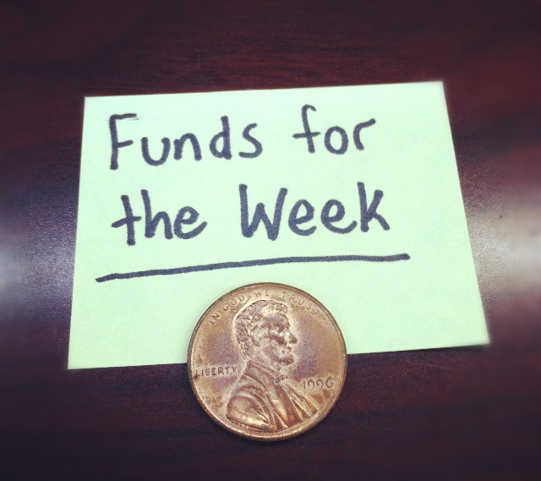
User Needs Identification
Domain Research and Need finding
Common themes from interviewees:
Most important filter tags
Process of purchasing art is similar across most people
Current approaches
Minimalistic design
Grouping only the most commonly used filters together
Notes:
The people we interviewed weren’t rich people who could afford to buy expensive art pieces, but broke college students who make up most of the college population. While we will continue to use the insights we’ve gotten from these interviews and domain research, we thought it would be important to identify this disparity between our interviewees and target audience.

Slide 8
Demonstration of Product
Notes:
© Copyright Showeet.com – Creative & Free PowerPoint & Google Slides Templates

Slide 9
Design Discussions
Notes:
© Copyright Showeet.com – Creative & Free PowerPoint & Google Slides Templates

Slide 10
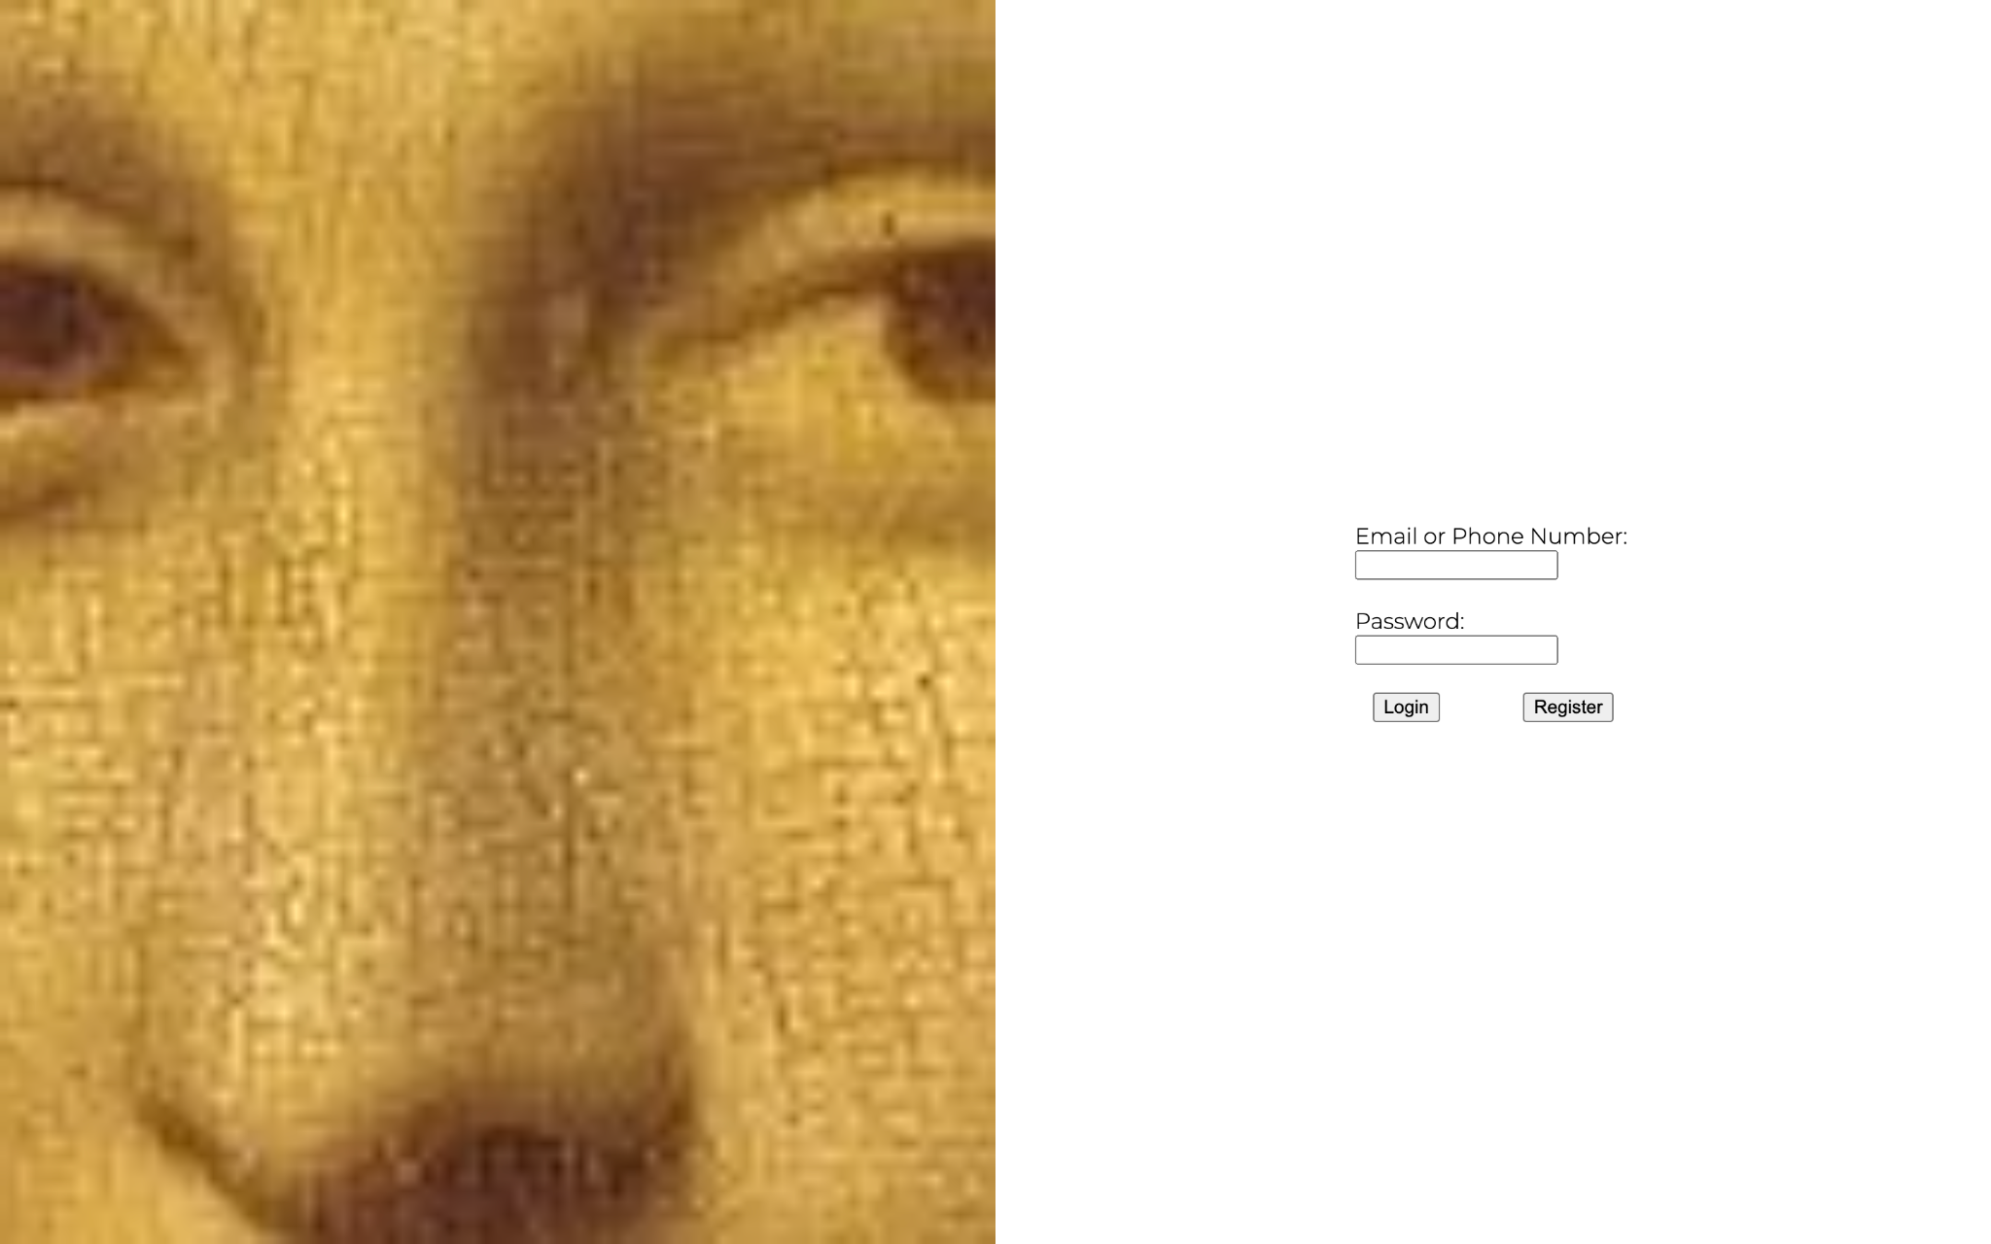
Login and Register Page
Notes:
The design idea behind the login and register page is rooted in the idea of deliberately making things difficult. This was discussed in chapter 6 of Design of everyday things. While they used security measures as an example, they also talked about the aspect of designers having strict control over who uses the application. This idea aligned with our client’s emphasis on exclusivity.
When taken to the login page, the user isn’t given any information or context aside from the login credentials. Furthermore, in order to actually register, an invitation code is required. The idea behind this is that the user should already know what the site is about from the person that gave them the invitation code.

Slide 11
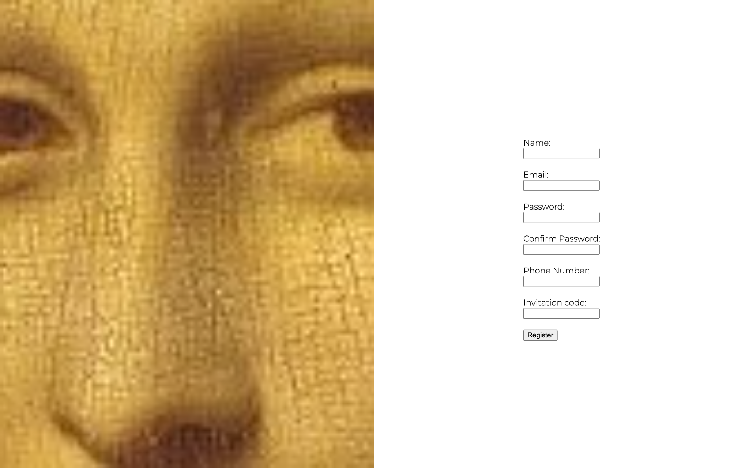
Login and Register Page
Notes:
The design idea behind the login and register page is rooted in the idea of deliberately making things difficult. This was discussed in chapter 6 of Design of everyday things. While they used security measures as an example, they also talked about the aspect of designers having strict control over who uses the application. This idea aligned with our client’s emphasis on exclusivity.
When taken to the login page, the user isn’t given any information or context aside from the login credentials. Furthermore, in order to actually register, an invitation code is required. The idea behind this is that the user should already know what the site is about from the person that gave them the invitation code.

Slide 12

Navigation Bar
Notes:
Before we talk about any of the other pages, I want to talk about the navigation bar, as it will be present in every page excluding the login and register page. The navigation bar follows three gestalt principles: proximity, similarity, and figure and ground. For proximity, the medium, artists, and price are grouped up together, indicating that they serve a similar function. Additionally, the Artket home page button, and the bookmark icon, are all spatially related in that they are all in the navigation bar and in the same x-axis. Thus, the user can infer that these buttons in the nav bar can be used for additional functionalities.
For similarity, again, the filters have the same font and font size to indicate that they all serve a similar function, that is, filters.
For figure and ground, the user can perceive that the background is the beige bar, and the figures are the functional buttons. This way, the user can easily identify and use these functionalities.

Slide 13
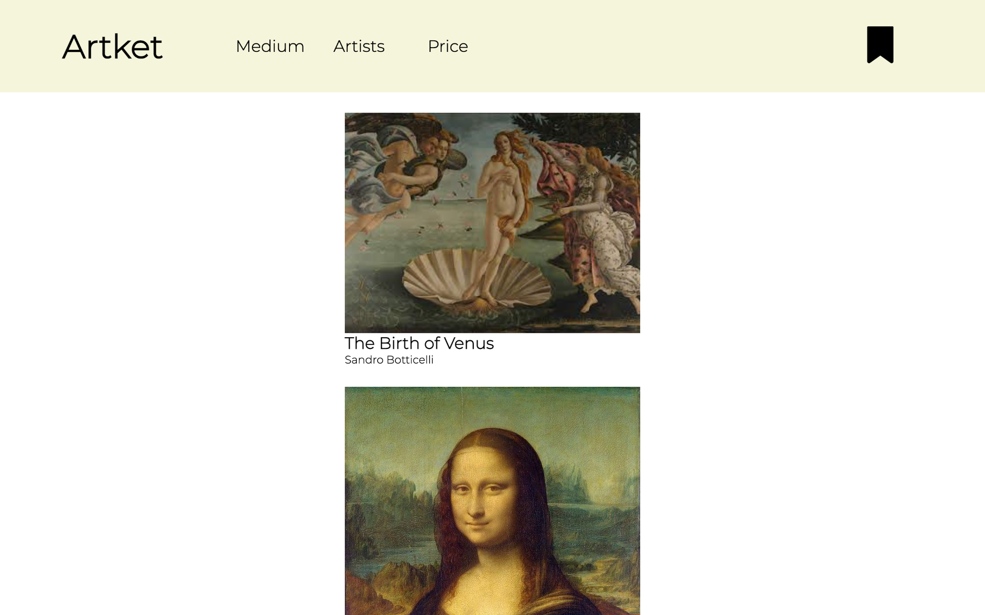
Colors
Notes:
In regards to the color scheme used, we mainly used three colors: white, beige, and black. The beige and white are used as background colors, as seen in the navigation bar and in the page. Beige and white were used in accordance to three of the guidelines for using colors: distinguishing colors using hues, using distinctive colors, and avoiding color pairs that color blind people cannot distinguish.
The beige navigation bar and the white background of the page only differ in hues. The reason we used these two similar colors is to avoid taking the user attention from the artwork to the navigation bar by using strong opponent colors.
In using distinctive colors, we used black as the text for both the navigation bar and the page. People perceive white and black very well as it is one of the color-opponent channels (called the luminance channel). In this way, the user can easily identify the information and functionality that is presented through the black text.
Additionally, beige and white, beige and black, and white and black, are color pairs that color-blind people can distinguish.

Slide 14
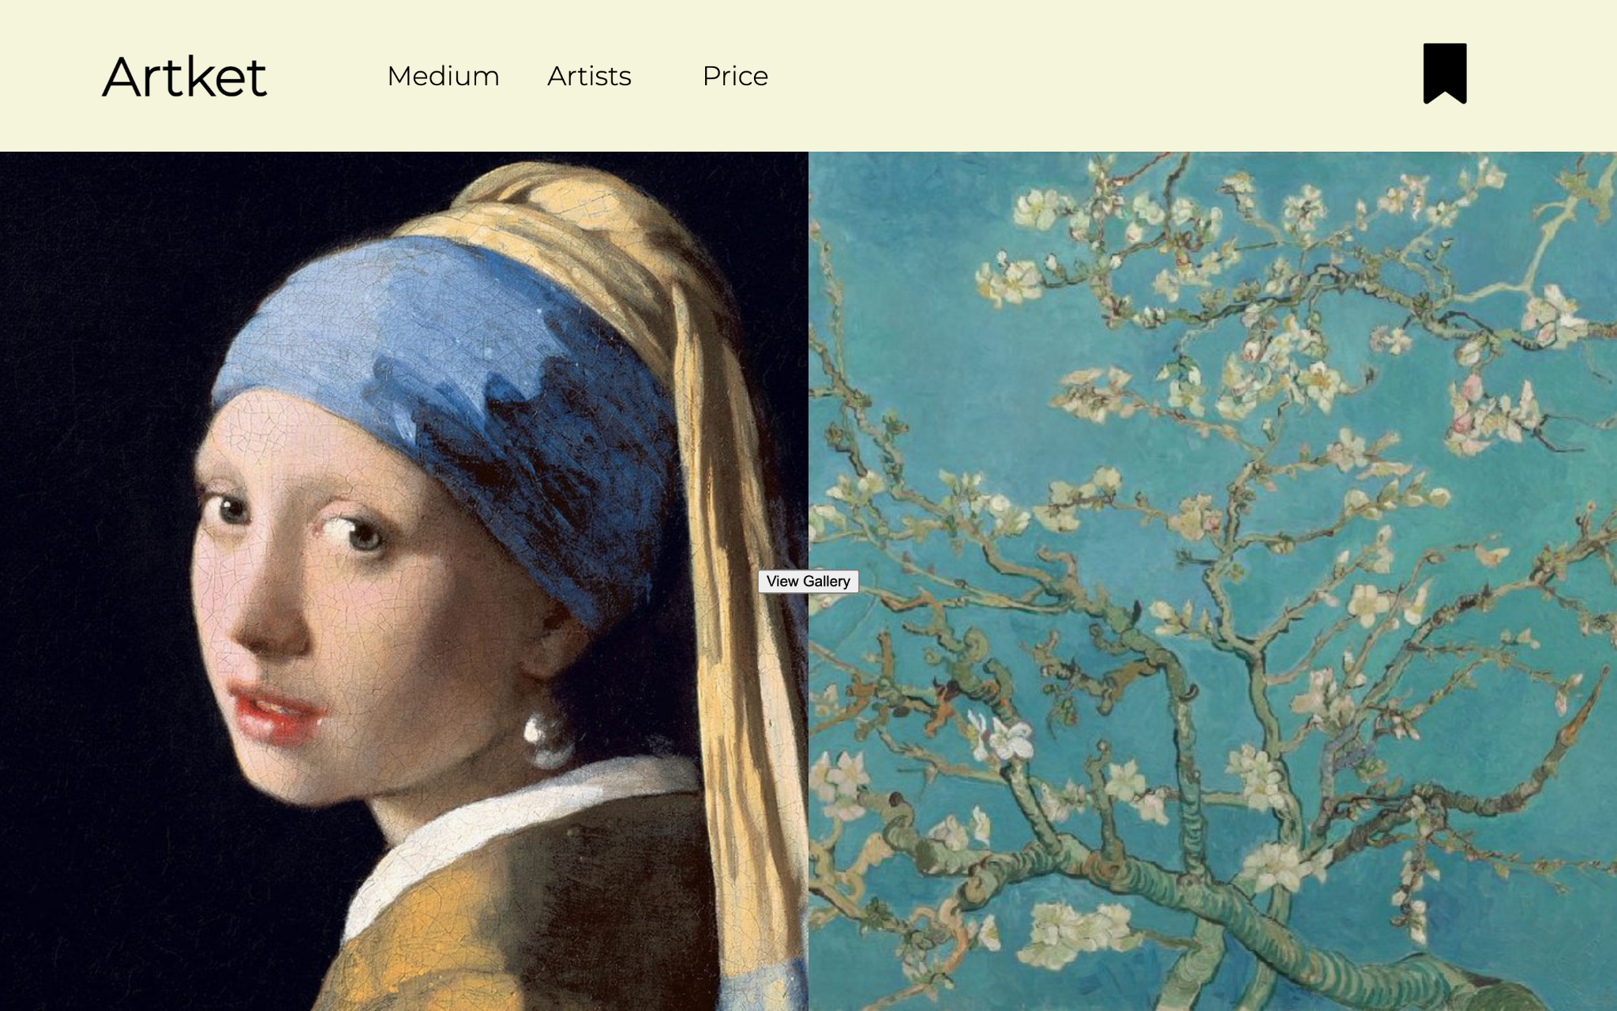
Home Page
Notes:
The home page mainly consists of three elements: images of two well-known artworks that each occupy half the width of the screen, and the “view gallery” button in the middle.
The view gallery is placed in the center as that is where the fovea is. Thus, that would be the focus of the user. The wording of the button was changed from “Begin your collection” to “View Gallery” as it caused some confusion from our interviewees.

Slide 15
Gallery Page
Notes:
In the gallery page, artworks are placed in the center so the user can focus on it more easily, since fovea is in the middle of the visual field (Chapter 5 of DWTMIM).
However, the text describing the name of the painting and the artwork is left-aligned as centered text can disrupt reading. Thus, while the text is at the center of the screen below the artworks it is left aligned, the alignment that most people find easier to read (Chapter 6 of DWTMIM)

Slide 16
Current Work-In-Progress
Creating the bidding, selling, and information page
Creating the saved artworks page, currently bidding page and user rank page
Adding responsiveness
Notes:
Since the project isn’t due until December 12th, there are still some parts of the project we are still working on. These include (read from the slides). In terms of responsiveness, we plan to follow the guideline of using colors redundantly along with cues by using colors for responsiveness. This would be similar to the one we already have for the filters.
These pages will follow the fundamental design patterns that we’ve set for the project, including color, layout, and positions of images and text.

Slide 17
Implementation Discussions
Notes:
The technologies we’ve used in order to implement our application were HTML, CSS, Flask, and SQLAlchemy. In terms of the front-end, HTML and CSS have greatly supported the process of implementing the design principles we have discussed. However, the main limitation with HTML and CSS seemed to be that it was limited to the box model. Designing everything in the website was constrained to the paradigm of boxes, which meant that some design principles were disregarded as it was much more difficult to implement them. In regards to the backend…

